Slide 1

Car Shop management system
Project By Md. Abdur Rashid

Slide 2
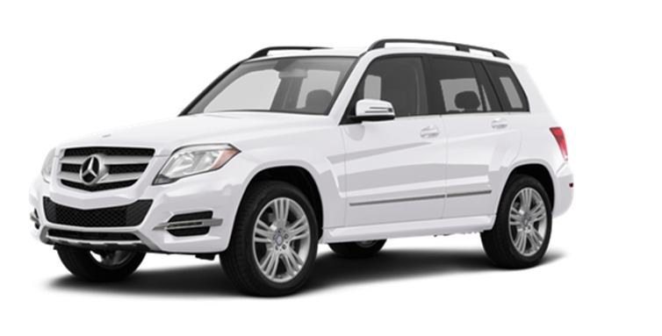
Introduction
Our car shop name is “Car Network”. The objective of this project is to develop a database on Car Shop Management System. From this project we can get a clear idea about how the database works and how we can use this.
“The Car Shop Management System” is one can go into almost required solution regarding the Car Shop.
There are various type of tabless available to manage brand_ambassador, car_details, customer, employee, payment_bill, purchase, stock, upcoming_cars.
The details of Car is store into the Car tables respective with all tables.

Slide 3
Introduction (cont.)
Each table contains primary key and unique keys.
There is one-to-one and one-to-many relations available between customer, paymentBill, purchase, stock, car_details.
We have implemented indexing on each tables of Car Shop Management System tables for fast query execution.

Slide 4

Scope
The scope of this project is to provide a realistic experience in the conceptual design, logical design, implementation, operation, and maintenance of a relational database.
The project could be implemented in an implemented in an average sized organization.
The data is directly stored in database in the hard disk of the Pc.

Slide 5
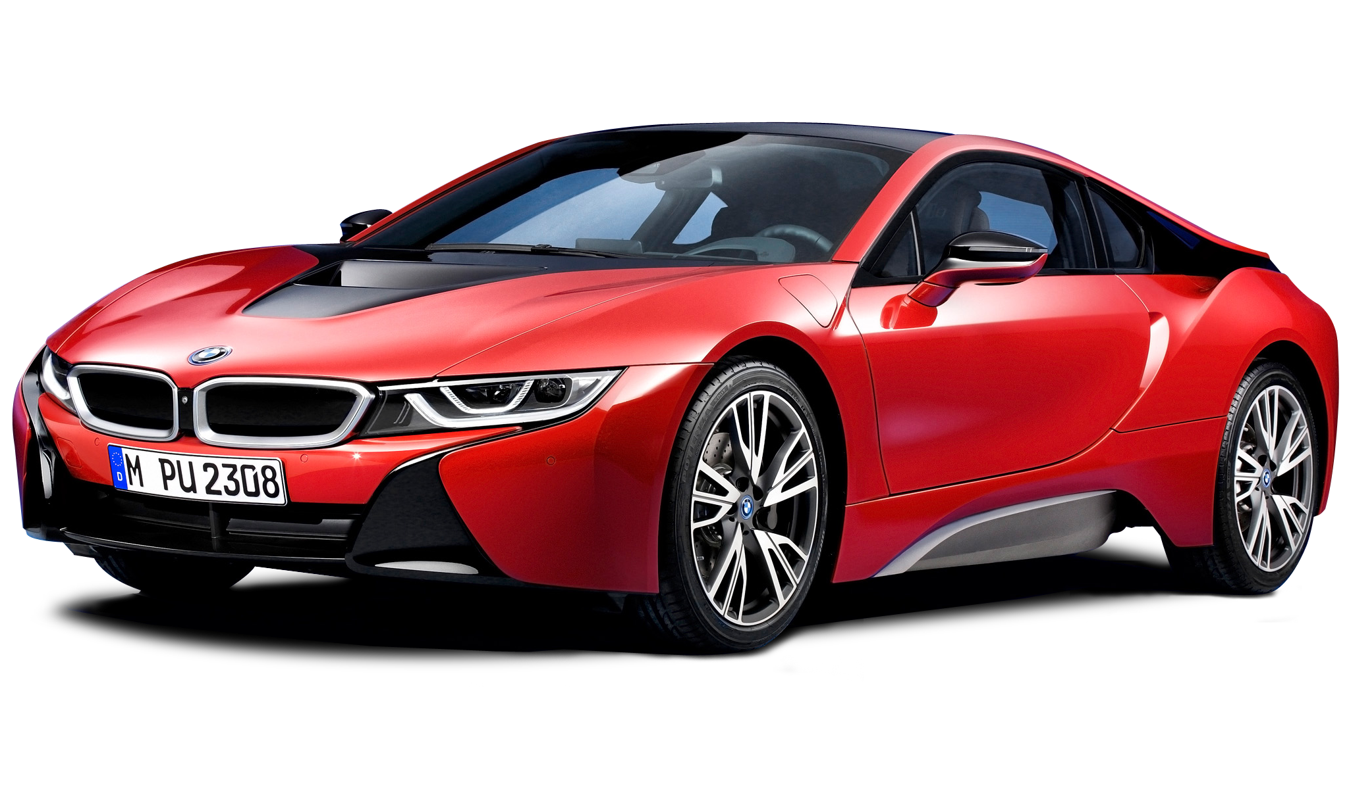
Features of car Shop Management System, Tables and their attributes
car_details : Attributes of car_details are car_id, car_model, car_type, brand, body_type, number_of_seat, drive_wheel, engine_type, engine_capacity, max_power, fuel_type, fuel_system, fuel_tank_capacity, top_speed, price_taka.
brand_ambassador : Attributes of brand_ambassador are brand_ambassador_id, brand_name, brand_ambassador_name, brand_ambassador_email, brand_ambassador_contact_no, brand_ambassador_address.
customer : Attributes of customer are customer_id, customer_name, customer_gender, customer_email, customer_contact_no, customer_address.
employee : Attributes of employee are emp_id, emp_name, emp_gender, emp_email, emp_contact, emp_address, emp_posting_branch, emp_salary, emp_responsibility.

Slide 6
Features of car Shop Management System, Tables and their attributes (cont.)
payment_bill : Attributes of payment_bill are pb_id, purchase_car_id, customer_id, customer_name, customer_contact, purchase_car_brand, car_model, car_price, paid_amount.
Purchase : Attributes of purchase are customer_id, car_id, purchase_date, paid_amount.
stock : Attributes of stock are stock_id, car_id, shop_branch.
upcoming_cars : Attributes of upcoming_cars Attributes of car_details are car_id, car_model, car_type, brand, body_type, number_of_seat, drive_wheel, engine_type, engine_capacity, max_power, fuel_type, fuel_system, fuel_tank_capacity, top_speed, price_taka.

Slide 7
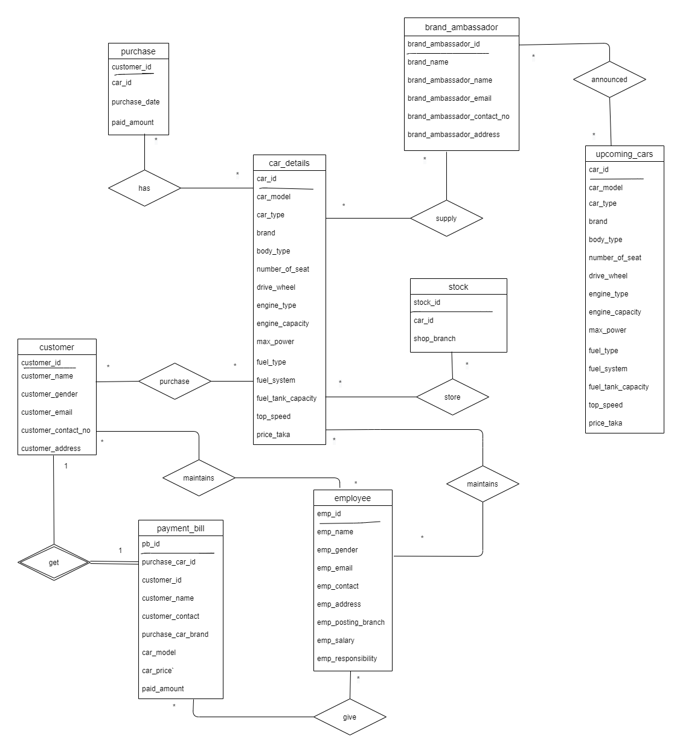
ER Diagram

Slide 8

Appendix
CREATE DATABASE : car_network
CREATE TABLE car_details ( car_id varchar(10), car_model varchar(45), car_type varchar(15), brand varchar(12), body_type varchar(30), number_of_seat int(2), drive_wheel varchar(15), engine_type varchar(10), engine_capacity varchar(9), max_power varchar(8), fuel_type varchar(10), fuel_system varchar(20), fuel_tank_capacity varchar(5), top_speed varchar(10) , price_taka int(12) )
CREATE TABLE brand_ambassador ( brand_ambassador_id varchar(8), brand_name varchar(18), brand_ambassador_name varchar(20) DEFAULT NULL, brand_ambassador_email varchar(20) , brand_ambassador_contact_no varchar(13), brand_ambassador_address varchar(30) )
CREATE TABLE customer ( customer_id varchar(6), customer_name varchar(20), customer_gender varchar(7), customer_email varchar(20), customer_contact_no varchar(15), customer_address varchar(30) )
CREATE TABLE employee ( emp_id varchar(7), emp_name varchar(20), emp_gender varchar(7), emp_email varchar(30), emp_contact varchar(15) DEFAULT NULL, emp_address varchar(30), `emp_posting_branch` varchar(20), emp_salary int(8), emp_responsibility varchar(50) )
CREATE TABLE payment_bill ( pb_id varchar(10), purchase_car_id varchar(10), customer_id varchar(10), customer_name varchar(20), customer_contact varchar(15), purchase_car_brand varchar(10), car_model varchar(35), car_price int(12), `paid_amount` int(12) )

Slide 9
Appendix (cont.)
CREATE TABLE purchase ( customer_id varchar(8), car_id varchar(15), purchase_date varchar(12), paid_amount int(12) )
CREATE TABLE stock ( stock_id varchar(10), car_id varchar(10), shop_branch varchar(15) )
CREATE TABLE upcoming_cars ( car_id varchar(10), car_model varchar(45), car_type varchar(15), brand varchar(12), body_type varchar(30), number_of_seat int(2), drive_wheel varchar(15), engine_type varchar(10), engine_capacity varchar(9), max_power varchar(8), fuel_type varchar(10), fuel_system varchar(20), fuel_tank_capacity varchar(5), top_speed varchar(10) , price_taka int(12) )

Slide 10
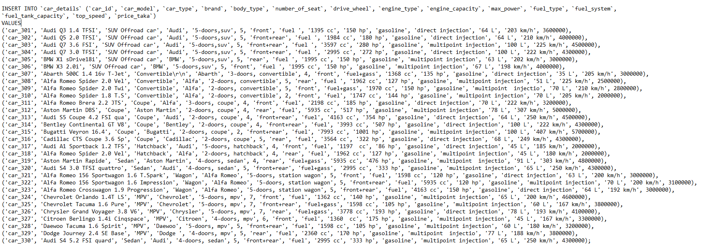
Data insert (car_details)

Slide 11
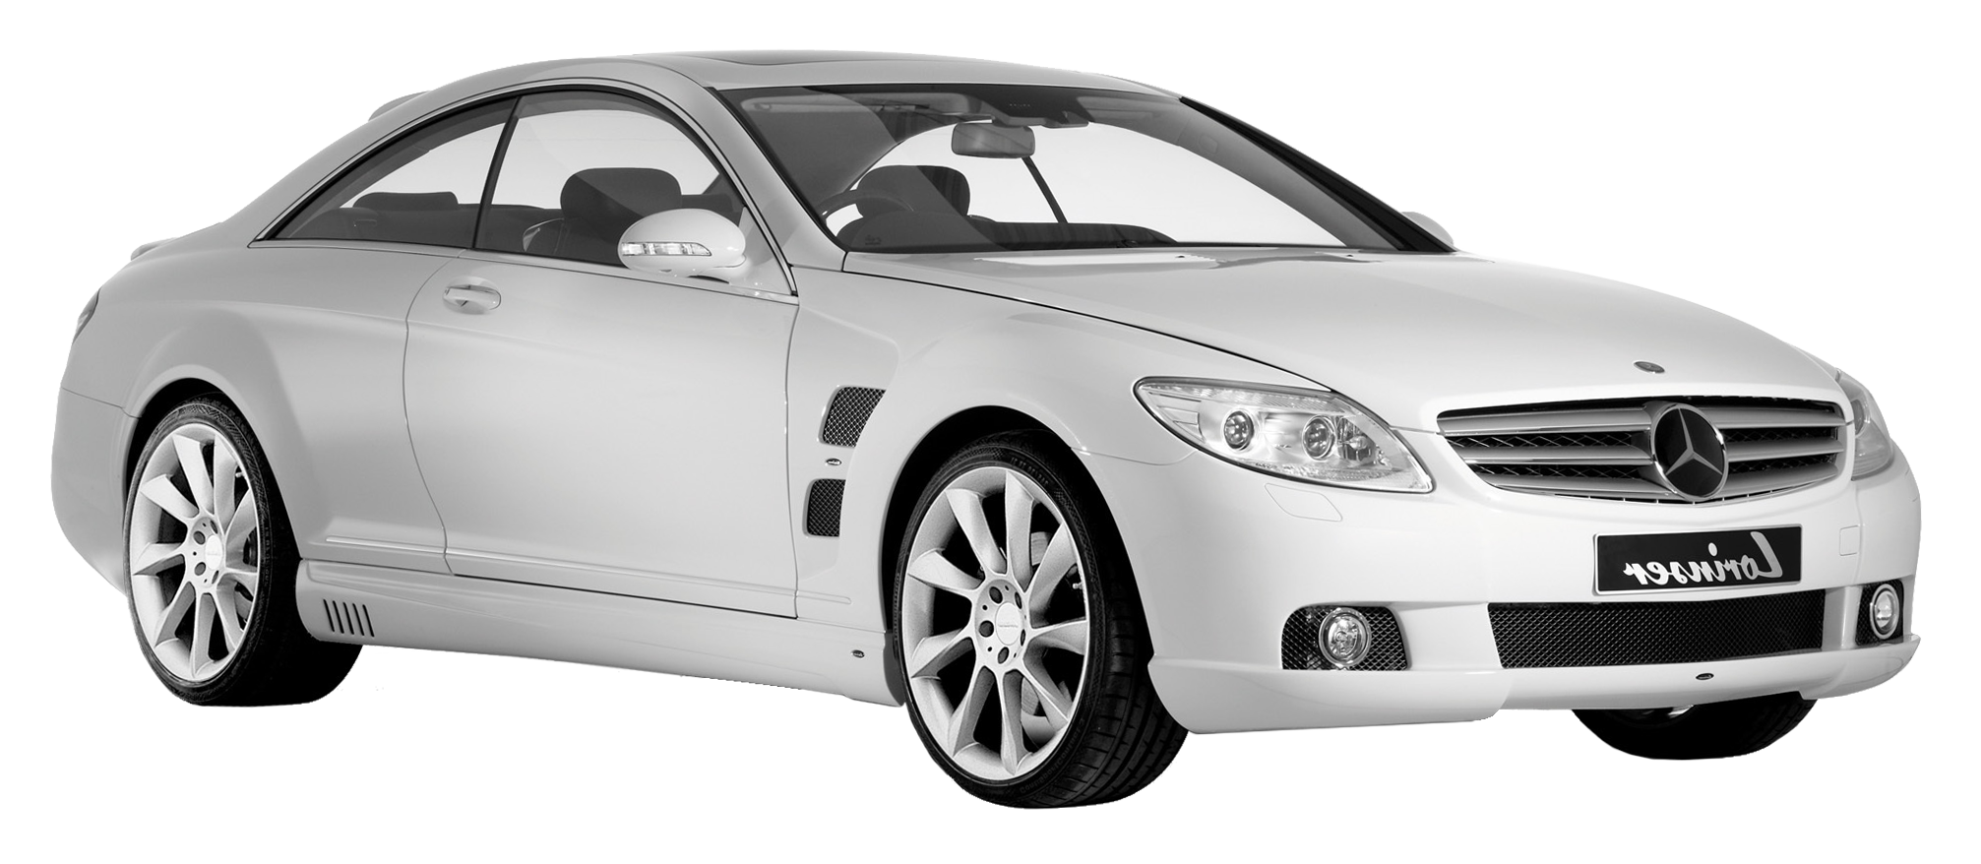
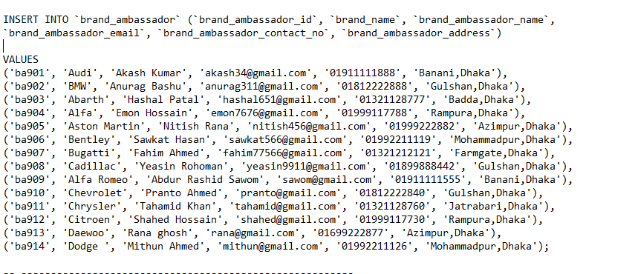
Data insert (brand_ambassador)

Slide 12
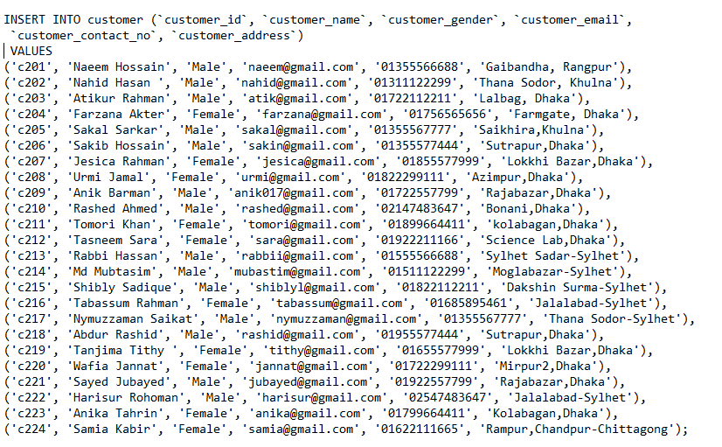
Data insert (customer)

Slide 13

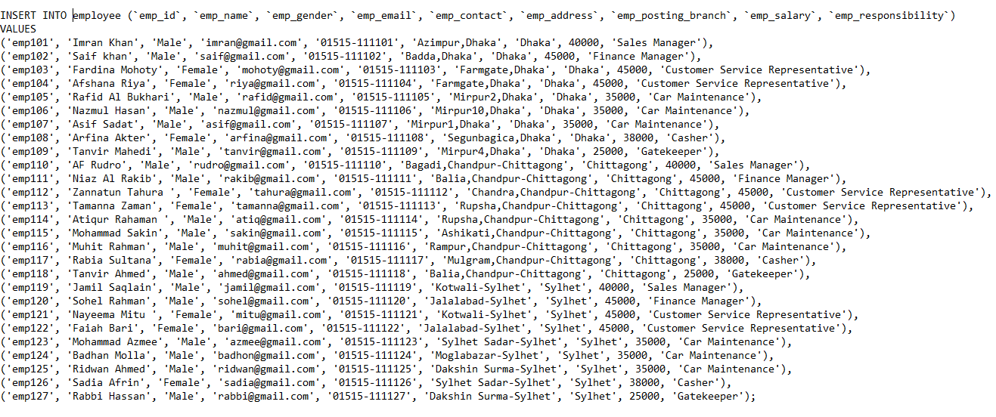
Data insert (employee)

Slide 14
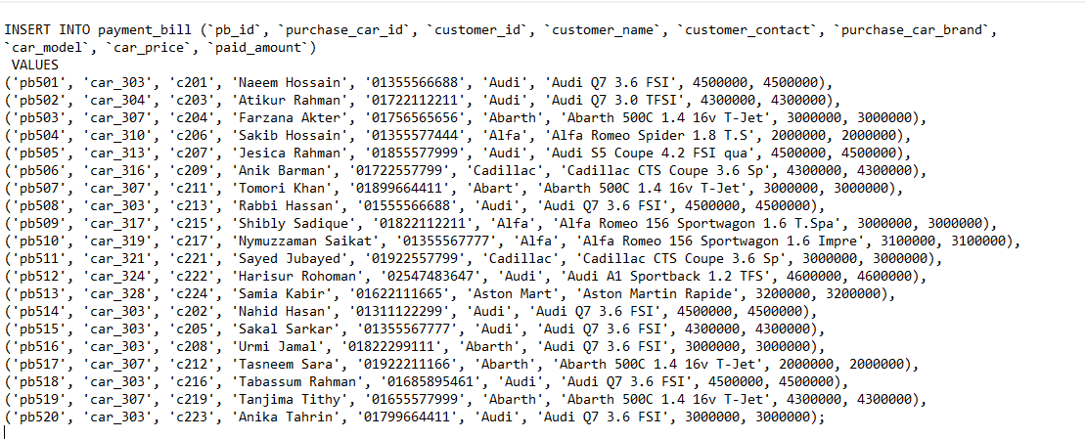
Data insert (payment_bill)

Slide 15
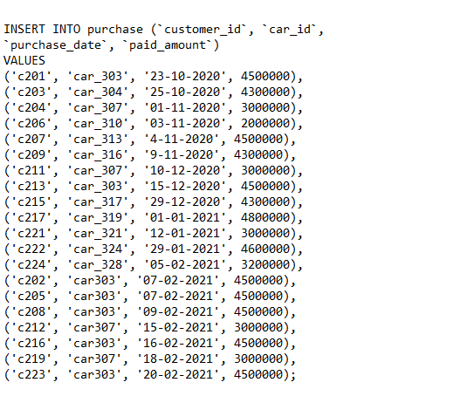
Data insert (purchase)

Slide 16
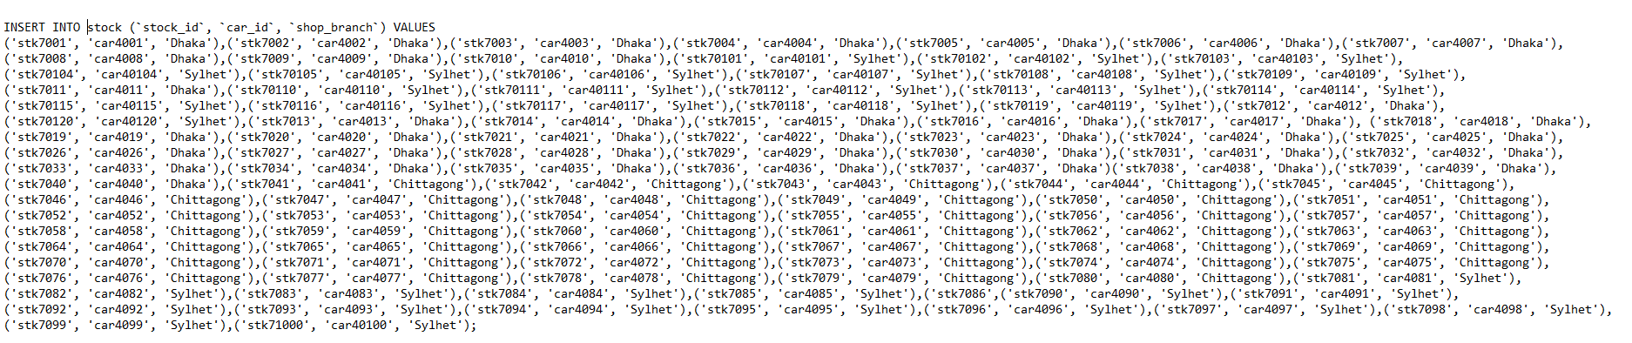
Data insert (stock)

Slide 17
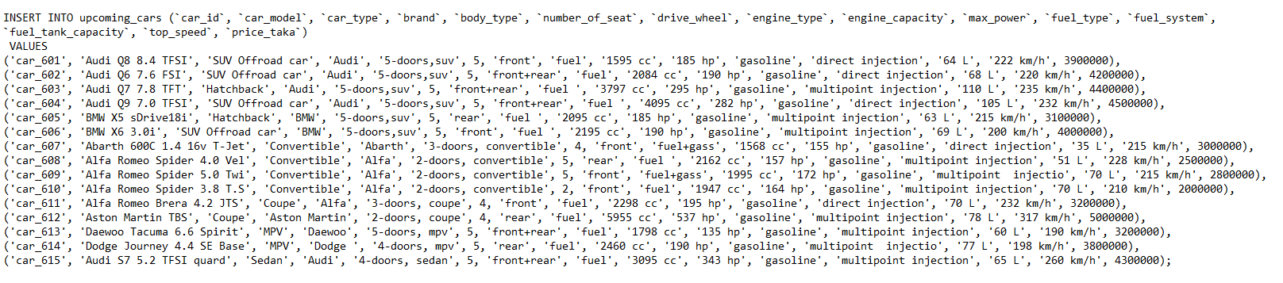
Data insert (upcoming_cars)

Slide 18

Thank You!!

